Slide 1
The primary photochemical process:
S + hγ → S*
Some primary photochemical process for molecules
AB· + C·
Dissociation into radicals
AB⁻ + C⁺
Ions Photoionization
ABC + hγ
ABC⁺ + e⁻
photoionization
ABC*
Activated molecules Photoexcitation
ACB
Intramolecular rearrangement
Photoisomerization

Slide 2
Secondary photochemical process
Energy transfer: A* + Q → Q*
donor
acceptor
Q* → P (sensitization), A*:sensitizer
Q* +A (quenching), Q:quencher
Photosensitization, photosensitizers, photoinitiator

Slide 3
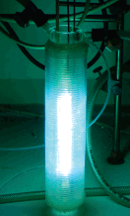

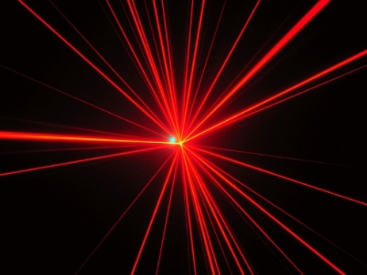
Equipment.
Light sources
Sun:
Free
Not practical
Example: 30 days in
Cairo sunlight
Mercury lamp:
Most popular
Versatile
Laser:
Monochromatic,
coherent
Possibility of extremely
high light intensities
Surface area low
Use to solve special
problems
Horspool, W.h Aspect of organic photochemistry, Acedemic Press Inc., New York, 1976

Slide 4
Synthetic Applications of Photochemistry
UV light: Organic compounds show absorbance in the UV region of the spectrum and hence UV light is used to facilitates reaction pathways that may not be accessible by thermal or other conventional methods
Many new bond formation strategies and rearrangements have been developed in addition to the application of photochemistry to complex molecule synthesis including natural products.

Slide 5
UV mediated-reactions
[2+2] cycloadditions
Norrish Type-I and Type-II Reactivity
Photochemical Rearrangements
Oxa-di-π-Methane Rearrangement (ODPM)
Photo-Fries Rearrangement

Slide 6
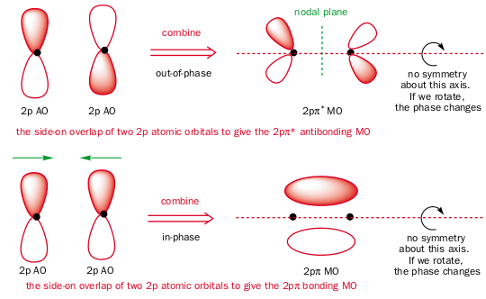
[2+2] Cycloadditions
[2+2] cycloadditions occur photochemically but NOT thermally
Analysis of molecular orbitals involved can explain the reason.
Analysis of the reaction in terms of the Highest Occupied Molecular Orbital (HOMO) and Lowest Unoccupied Molecular Orbital (LUMO) can help. Remember how to construct them?

Slide 7
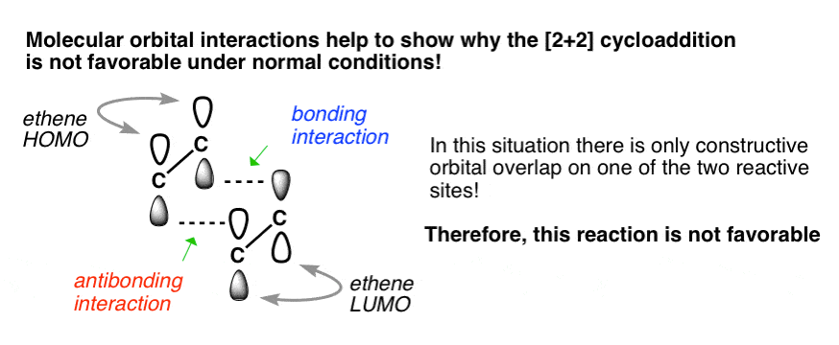
[2+2] Cycloadditions
The overlap required for bond formation cannot proceed because one reaction site cannot have bonding interaction between the lobes of the HOMO and LUMO.

Slide 8
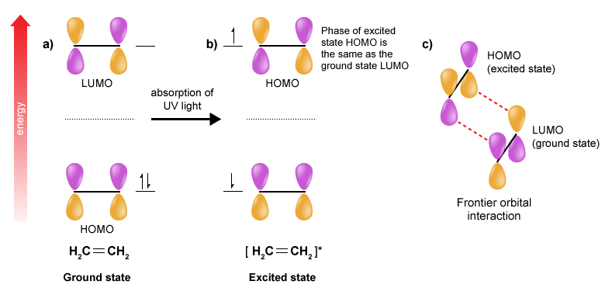
[2+2] Cycloadditions
Upon exposure to UV light, one electron gets excited from the HOMO to the (old) LUMO thereby generating an excited state HOMO (see figure below).
The HOMO of the excited state alkene reacts with the LUMO of a ground state alkene to give the product.
bonding interaction for both

Slide 9
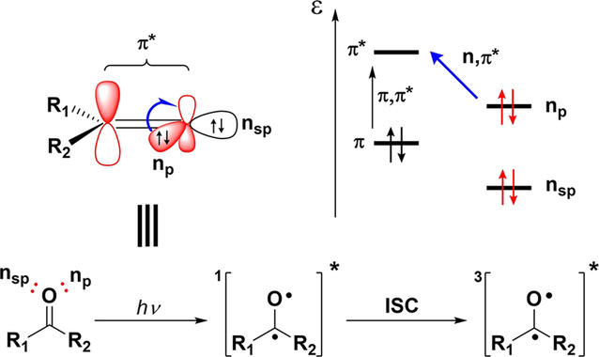
Photochemistry of Ketones
Ketones have two nonbonding lone pairs on the oxygen atom occupying two nondegenerate n_{p} and n_{sp} orbitals (see below). For simple ketones, the first ionization potential is attributed to the n_{p}→π* transition.
The n_{p}, π * state is well represented by a biradical-like structure because of the presence of an unpaired electron in a nonbonding orbital (see below). Normally, it rapidly suffers an intersystem crossing (ISC) from the singlet (S1) to triplet (T1) statedue the fact that they are very close in energy.

Slide 10
The biradical-like character and the easy access to the triplet excited state are responsible for the reactivity ofphotoexcited carbonyl compounds. In the biradical character, the oxygen radical portion is extremely reactive, triggering the majority of transformations. On the other hand, the reactivity of the carbon-based radical is modulated by its substituents R1 and R2, which can stabilize this center or make it more reactive.
Among the transformations presented, the α-cleavage (known as Norrish type I) is shown below.
In the Norrish type I (see below), the photoexcited ketone decomposes reforming the C=O bond and concomitantly suffering a α-C-C bond cleavage to afford an alkyl radical and a more stable acyl radical. This strategy has already found many synthetic applications and, among other radical pathways, the acyl radical can suffer a decarbonylative event to generate another alkyl radical.

